Slide 1
Chapter 2
Web Development Using HTML
Notes:
Lecture slides prepared for “Computer Organization and Architecture”, 10/e, by William Stallings, Chapter 2 “Performance Issues”.

Slide 2
Chapter 2 part 3
HTML Elements
(Working with Images and Multimedia)

Slide 3
Outline
Working with Multimedia
Image element
Image map
Picture element
Source element
Audio element
Video element
The <track> element
Figure and figure caption elements

Slide 4
1. HTML Images
A picture speaks a thousand words.
Without images, web content would be quite boring.
Images enhance visual appearance of the web pages by making them more interesting and colorful.
The <img> tag is used to embeds images in the HTML documents.
It is an empty element and contains attributes only.
it is an inline element and the content categories are embedded content ---> phrasing content ---> Flow content.
The <img> tag has two required attributes:
src - Specifies the path to the image
alt - Specifies an alternate text for the image

Slide 5
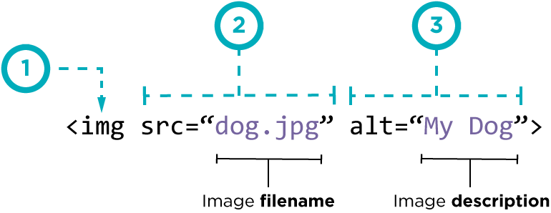
Cont’d
Syntax:
(1) – img is an image tags which embed a given /picture/image
(2) - src attribute is short for source
it tells the tag which image to load by specifying the image path and name.
(3) – alt attribute is short hand for alternative text

Slide 6
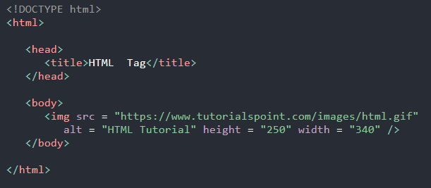

Cont’d
Example:
Absolute vs. Relative URLs
Absolute links are URLs that contain the protocol, the domain name and the full path to the resource.
Relative links are URLs that are 'relative' to the file that you are using in, or linking from.
Relative path can be specified down in the directory tree starting from the root directory.

Slide 7
Cont’d
The alt attributes:
Defines an alternative text description of the image
A browser might not display images for several reason, such as:
The image is invalid or an unsupported type or not available
The image cannot to be loaded because of slow connection
Non-visual browsers (such as those used by people with visual impairments)
The user chooses not to display images (saving bandwidth, privacy reasons)
In these cases, the browser may replace the image with the text in the element's alt attribute.
Omitting alt indicates that the image is a key part of the content and no textual equivalent is available.
The alt attribute is considered good for SEO prospective.
Therefore, provide a useful value for alt attributes whenever possible

Slide 8
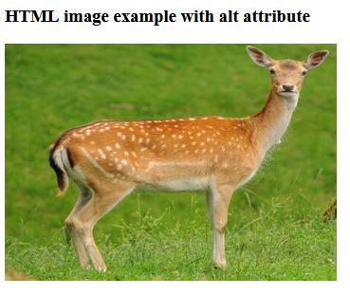
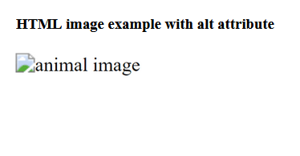
Cont’d
The empty alt attributes:
Indicates that this image is not a key part of the content
Non-visual browsers may omit it from rendering the image.
Visual browsers will also hide the broken image icon and the image failed to display.
Authoring meaningful alternate descriptions
An alt attribute's value should clearly and concisely describe the image's content.
It should not describe the presence of the image itself or the file name of the image.

Slide 9
Cont’d
Other attributes:
Attribute | Value | Description
crossorigin | anonymous use-credentials | It allows images from third-party sites that allow cross-origin access to be reused
height | pixels or % | Specifies the height of the image.
width | pixels or % | Sets the width of an image
ismap | URL | Defines the image as a server-side image map.
usemap | #mapname | Defines the image as a client-side image map and used along with <map> and <area> tags.
decoding | sync / async / auto | Provides an image decoding hint to the browser
loading | eager / lazy | Indicates how the browser should load the image
srcset | URL | One or more strings separated by commas, indicating possible image sources for the user agent to use
sizes | Media condition, Source size value | One or more strings separated by commas, indicating a set of source sizes

Slide 10
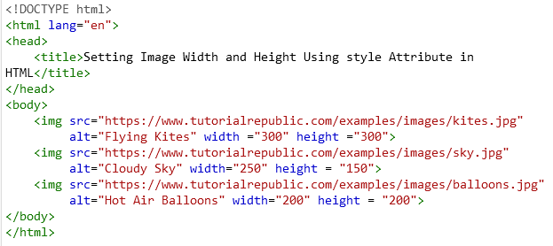

Cont’d
Example:
Output:
Note:
It's a good practice to specify both the width and height attributes for an image, so that browser can allocate enough space for the image before loading it.
Otherwise, image loading may cause distortion or flicker in your website layout.

Slide 11
Cont’d
Responsive Images the Simple Way (using sizes, src, srcset attributes)

Slide 12
Cont’d
Supported image formats
The image file formats that are most commonly used on the web are:
APNG (Animated Portable Network Graphics)
— Good choice for lossless animation sequences (GIF is less performant)
AVIF (AV1 Image File Format)
— Good choice for both images and animated images due to high performance
GIF (Graphics Interchange Format)
— Good choice for simple images and animations.
JPEG (Joint Photographic Expert Group image)
— Good choice for lossy compression of still images (currently the most popular)
PNG (Portable Network Graphics)
— Good choice for lossy compression of still images (slightly better quality than JPEG)
SVG (Scalable Vector Graphics) - vector image format
—Use for images that must be drawn accurately at different sizes.
WebP (Web Picture format)
— Excellent choice for both images and animated images

Slide 13
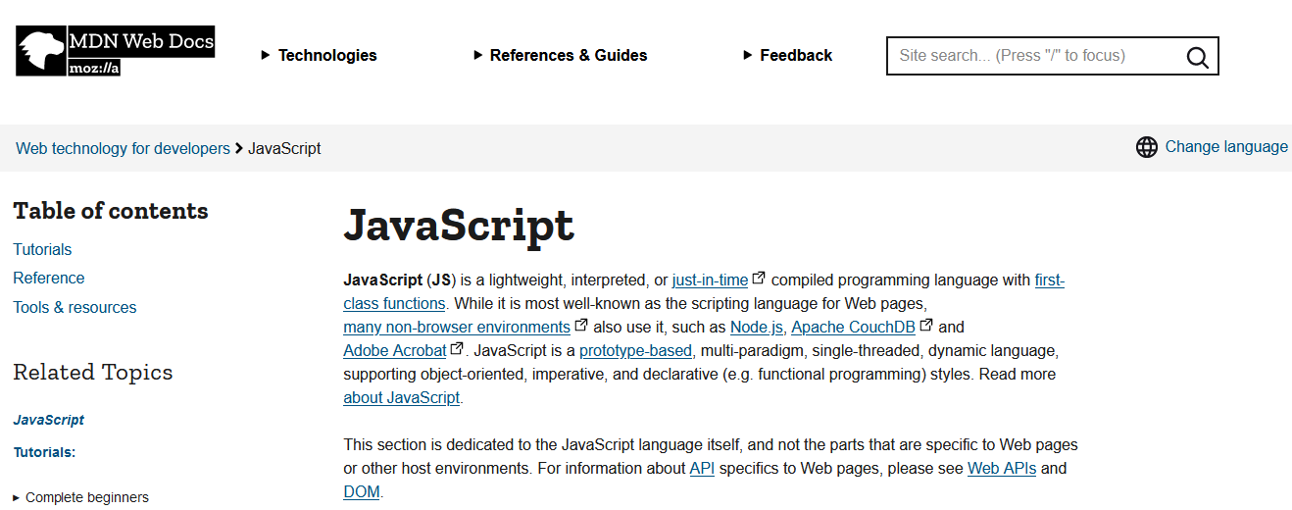
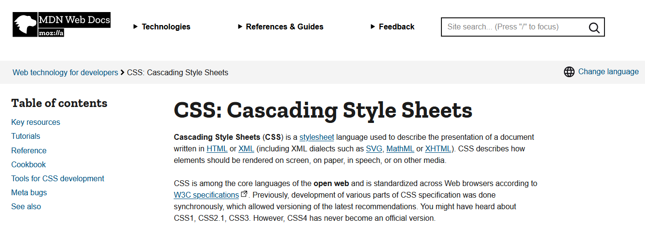
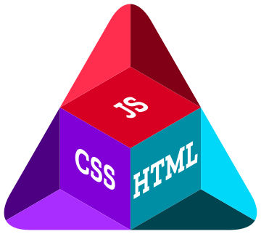
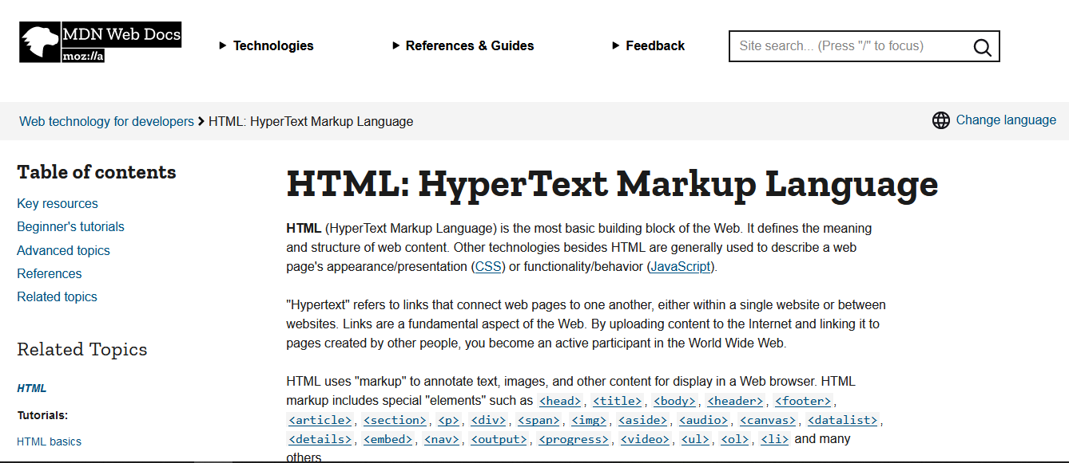
2. Creating Image Map
An image map is an image with clickable areas

Slide 14
Cont’d
Image map is defined by the <map> element with <area> elements
The idea is to be able to perform different actions depending on where in the image you click.
It is an inline element and belongs to the phrasing content ----> Flow content model.
The <map> tag has one required attribute called name that gives the map a name so that it can be referenced.
The name attribute must:
Has a non-empty value with no space characters
Has a unique value – two map element in the same document not allowed to have the same name.

Slide 15
Cont’d
How Does it image map Works?
The image is inserted using the <img> tag.
Here the <img> element is different from other images because it require a usemap attribute
Usemap attribute
Its value starts with a # followed by the name of the image map.
Used to create a relationship between the image and the image map.
Then, the <map> element is used to create an image map, and is linked to the image by using the required name attribute.
Then, the clickable areas are defined and added using an <area> element.

Slide 16
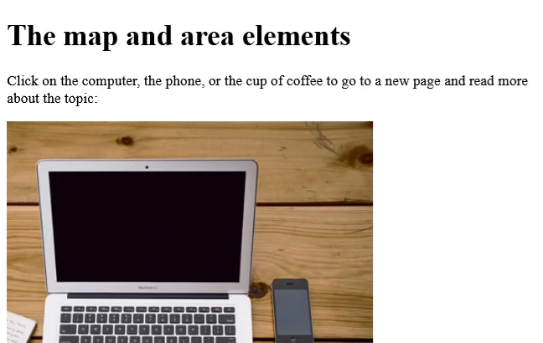
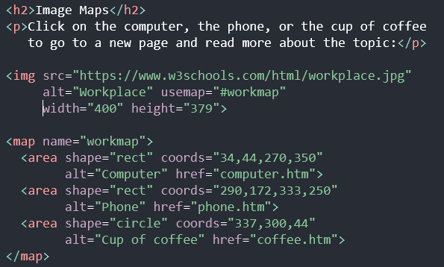
Cont’d
Example 1:

Slide 17
Cont’d
The <area> element
It defines an area inside an image map that has predefined clickable areas.
Allows geometric areas on an image to be associated with hypertext link.
Used only within a <map> element.
It is defined with (required) attributes shape and coords.
Shape attribute - specifies the shape of the clickable area such as rectangle, circle, square, and polygon.
Coords attribute - defines the coordinates of areas inside the image.

Slide 18
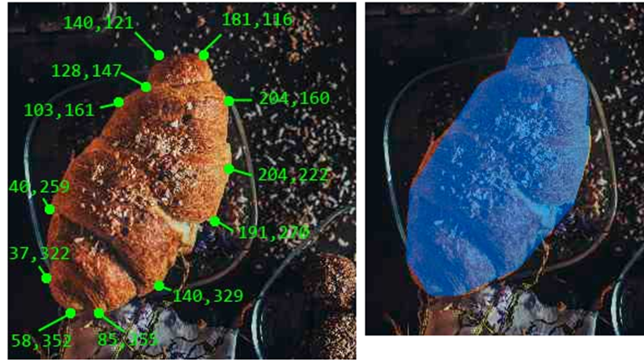
Cont’d
How coordinate works?
Shape attribute possible values
circle, rect, poly, default
Cords attribute possible values
x, y, r (circle) where x, y specify the center and r is the radius of circle
Pair of x,y (rect) that specify the left, top, right, bottom coordinates of rectangle
x1,y1,x2,y2,x3,y3,..(polygon) that the polygon vertices.
Note: The easiest technique is using map coordinate generator

Slide 19
Cont’d
Other <area> attributes
Attribute | Value(s) | Description
alt | Text | Alternative text to display if image can not be displayed
target | _self, _blank, _parent, _top | Specifies where to display the linked resource (current window, new window, the parent frame, full width in the original (same) window)
href | URL | Determine the hyperlink destination for the active (clickable) area.
hreflag | language_code | The language of the linked resource. Must specified this attribute if you provide a value for the href attribute
download | File name | Indicates that the hyperlink will be used to download a resource
rel | alternate, author, help, next, bookmark, license, nofollow, noreferrer, prefetch, prev, search, tag | Determine the relationship between the current document and the hyperlink Used if a value for the href attribute is provided.

Slide 20

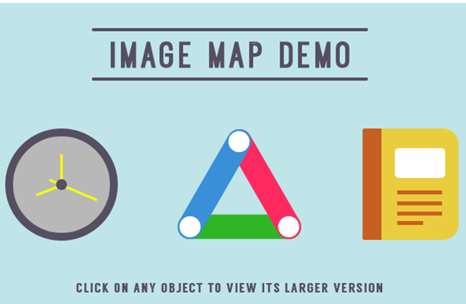
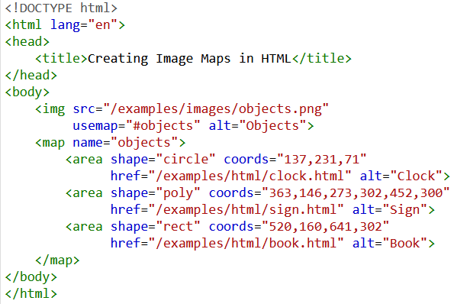


Cont’d
Example 2:

Slide 21
3. The <picture> and <source> Element
The <picture>
Unlike <img> tag, it offer alternative versions of an image for different display/device scenarios.
Like <img> tag, it is also an inline element and the content categories are embedded content ---> phrasing content ---> Flow content.
It nest a single <img> element and zero or more <source> elements
The <img> element serves two purposes:
It describes the size and other attributes of the image and its presentation.
It provides a fallback in case none of the offered <source> elements can provide a usable image.
Always specify the <img> element as the last child element of <picture> element

Slide 22
Cont’d
The <source> Element
It specifies multiple media resources for the <picture> element.
It also used with the <audio> element, and the <video> element.
It is an empty element (or void element) and also doesn’t has content model
Commonly used to offer the same media content in multiple file formats in order to provide compatibility with a broad range of browsers.
How <picture> and <source> elements work?
The browser will consider each child <source> element and choose the best match among them.
If no matches are found or the browser doesn't support the <picture> element then the URL of the <img> element specified in the src attribute is selected.

Slide 23
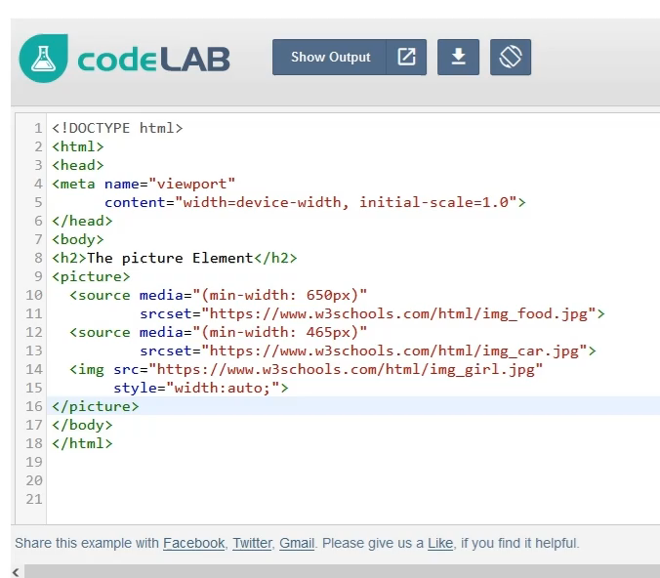
Cont’d
Example 1:
Considered If none of the source match the view point then

Slide 24
Cont’d
The <source> attributes
Attribute | Value | Description
media | media_query | media query of the resource's intended media Accepts any valid media query that would normally be defined in a CSS
sizes | media condition-length pairs | Specifies list of media source sizes for different page layouts Each source size consists of a comma-separated list of media condition-length pairs. E.g. sizes = “(max-height: 500px) 1000px”
src | URL | Required when <source> is used in <audio> and <video>. Specifies the URL of the media file
srcset | URL | Required when <source> is used in <picture>. Specifies the URL of the image to use in different situations
type | MIME-type | Specifies the MIME-type of the resource

Slide 25
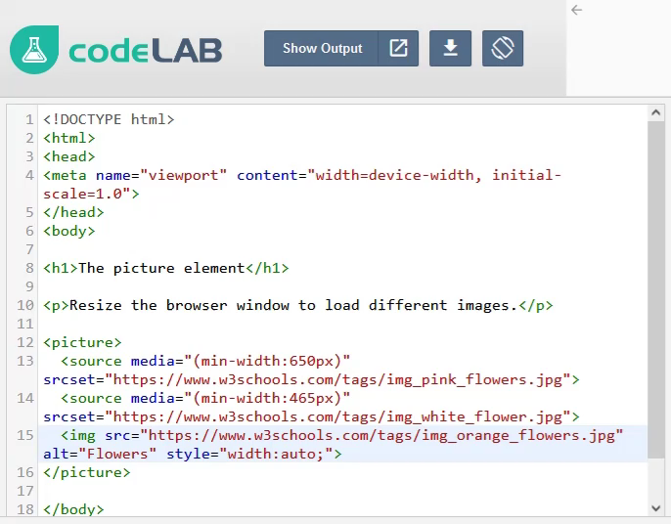
Cont’d
Example 2:
Considered If none of the source match the view point then

Slide 26
Cont’d
Common use cases for <picture>
Bandwidth
For small screen or device, it is not necessary to load a large image file.
By loading the most appropriate image for the viewer's display, the <picture> element allow saving bandwidth and speeding page load times .
Format Support
Some browsers or devices may not support all image formats.
With the <picture> element, you can add images of all formats, and let the browser to find the supported format
Art direction
Cropping or modifying images for different media conditions.
E.g. loading a simpler version of image which has too many details, on smaller displays

Slide 27
5. Audio and Video Elements
Before HTML5 there hasn't been a standard multimedia on web
Most videos were shown through a plugin. However, not all browsers have the same plugins
HTML5 features include native audio and video support without the need for Flash/a plugin.
A standard way to include multimedia contents (video or audio) on web.
The <audio> tag - embed sound content in web documents
The <video> tag - embed a media player which supports video playback.
The <source> tag – specify the source of media both for audio and video.
Both <audio> and <video> tags require the media controls.

Slide 28
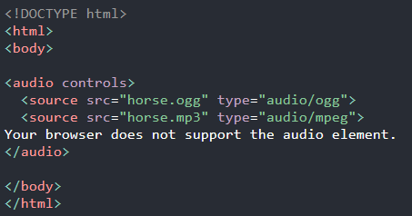
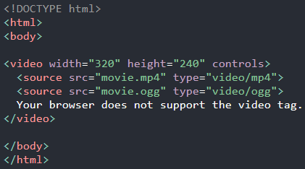
Cont’d
Media Sources
One or more media sources are represented using the src attribute and the <source> element.
Examples:

Slide 29
Cont’d
Some attributes of <audio> and <video> elements
Attribute | Value | Description
autoplay | autoplay | A Boolean attribute: if specified, the audio/video will automatically begin playback as soon as it is ready
controls | controls | if specified, the controls displayed to allow the user to control audio/video playback, including volume, seeking, and pause/resume.
loop | loop | Audio/video will start over again, every time it is finished
muted | muted | A Boolean attribute that indicates whether the audio will be initially silenced. Its default value is false.
preload | non / auto / metadata | Enumerated attribute which intended to provide a hint to the browser what content is loaded before the media played.
height | pixels | Sets the height of the video player
width | pixels | Sets the width of the video player
poster | URL | An image to be shown while the video is downloading, or until the user hits the play button

Slide 30
Cont’d
HTML Audio and Video Formats
There are three supported video and audio formats.
The browser support for the different formats is given below:
Browser | Video format |  |  | Audio format
Browser | MP4 | WebM | Ogg | MP3 | WAV | OGG
Edge | YES | YES | YES | YES | YES* | YES*
Chrome | YES | YES | YES | YES | YES | YES
Firefox | YES | YES | YES | YES | YES | YES
Safari | YES | YES | NO | YES | YES | NO
Opera | YES | YES | YES | YES | YES | YES

Slide 31
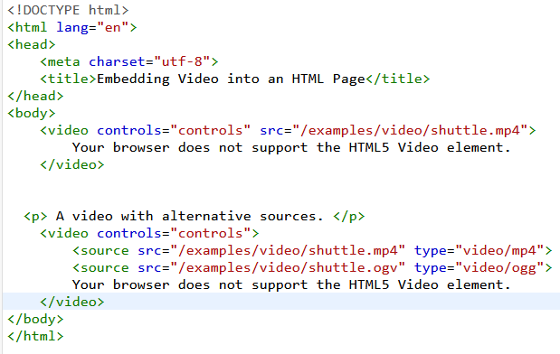
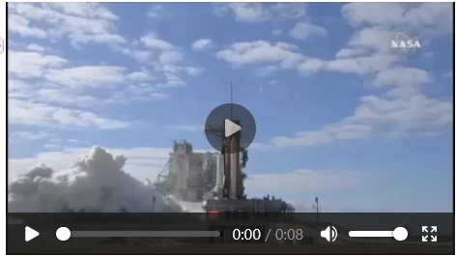
Cont’d
Example: HTML Video

Slide 32
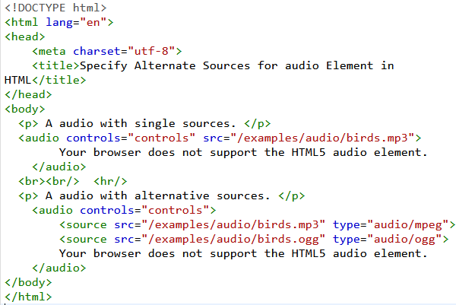
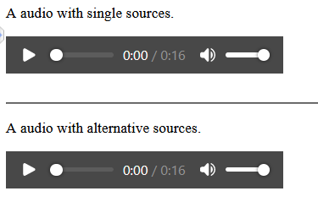
Cont’d
Example: HTML Audio

Slide 33
6. The <track> Element
HTML <track> tag is used to define time-based text tracks for a media file.
It must used as child element of <audio> and <video> elements.
It is used to specify subtitles, caption files or other files containing text, that should be visible when the media is playing.
Tracks are formatted in WebVTT format (.vtt files).
Example:

Slide 34
Cont’d
The <track> tag-specific attributes
Attribute | Value | Description
default | default | It specifies that the track should be enabled unless the user’s preferences indicate that another track is more important.
kind | captions / chapters descriptions / metadata subtitles | It specifies that which type of text track you want to add.
label | text | It specifies the title of the text track.
src | URL | It defines the URL of the track file.
srclang | language_code | It defines the language of the track text content, such as English, Germany, etc.

Slide 35
6. The <track> Element
How to create WEBVTT file:
In the text editor (notepad)
Write WEBVTT as the first line in the editor
Leave a blank line
Specify the time duration in the proper format
00:01.000 --> 00:04.000
Enter and write your text which you want to add a subtitle or caption
- Never drink liquid nitrogen.
Repeat step 3 to 5 until you finish it.
Save it using .vtt extension.
Example 1:
WEBVTT - This file has cues.
00:01:14.815 --> 00:01:18.114
- What?
- Where are we now?
00:01:18.171 --> 00:01:20.991
- This is big bat country.
00:01:21.058 --> 00:01:23.868
- [ Bats Screeching ]
- They won't get in your hair.
- They're after the bugs.
Note: For more details checkout - https://developer.mozilla.org/en-US/docs/Web/API/WebVTT_API

Slide 36
Cont’d
Example: Audio and video track

Slide 37
6. The <figure> and <figurecaption> Elements
The <figure> element
Specifies self-contained content, like illustrations, diagrams, photos, code listings, poem script etc.
Its content is related to the main flow, but its position is independent of the main flow, and if removed it should not affect the flow of the document.
The <figurecaption> element
Represents a caption or legend describing the contents of <figure> element which is its parent.
Can be placed as the first or last child of the <figure> element.
Both <figre> tag and <figurecaption> tag don't have any specific attribute

Slide 38
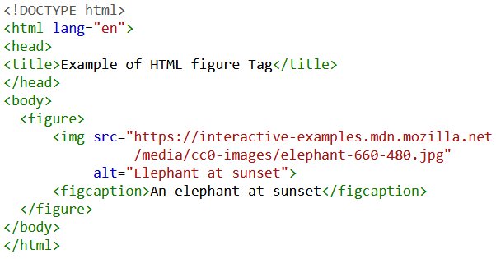
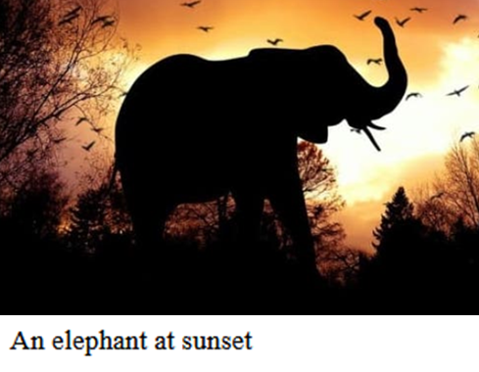
Cont’d
Example 1:
Note
The figure, its caption, and its contents are referenced as a single unit.

Slide 39
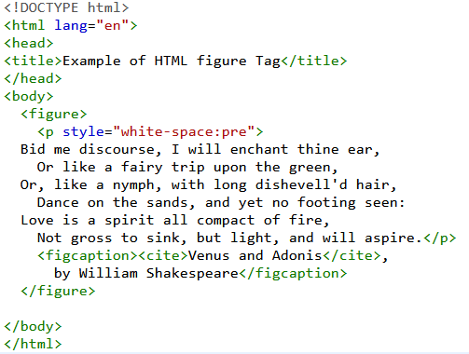
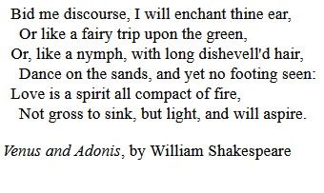
Cont’d
Example 2:
Output
Note:
Only one <figcaption> element can be nested within a <figure> tag although the <figure> element itself may contain multiple other elements like <img> or <code>

Slide 40
Summary
The <img> element is used to add images to a web page.
The <img> tag has two primary attributes (need to be specified always) supported in standard HTML:
src - The location and filename of the image to include.
alt - A text string to substitute for the image in text-only browsers.
The images should saved at the size it will be used on the web page and in the appropriate format.
An image map is an image with clickable areas which created by <map> element.
The <picture> element offer alternative versions of an image for different display/device scenarios.
HTML5 introduces new <video> and <audio> elements for adding video and audio to web pages, but these are only supported in the latest browsers.
Browsers that support the HTML5 elements do not all support the same video and audio formats.

Slide 41
Exercise
Discuss the image load errors.
Even though the <img> is an empty element (has no content) it includes an image into your web page. Does it not contradict with the definition of empty element?
What the rules for creating images for a website?
Discuss the common image format supported by most browsers.
Explain the difference between image dimension and image resolution.
Explain how to create image map.
How to provide alternative image source to support different device/display scenario?

Slide 42
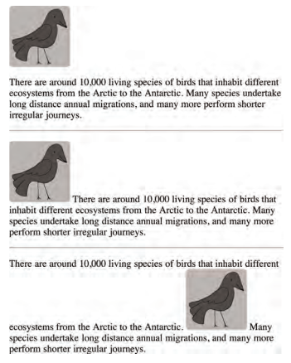
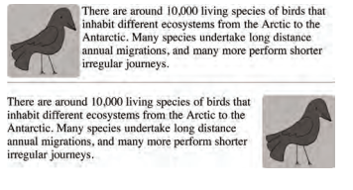
Practical Exercise
[old coding style] Write HTML code to place image within paragraph and produce the below output

Slide 43
Practical Exercise
[old coding style] Write HTML code to place image within paragraph and produce the below output
Create an image that composed of various Ethiopian Universities logo and then create image map to navigate to the official site of the Universities.

Slide 44
Reading Resources/Materials
Chapter 14:
P. Deitel , H. Deitel; C++ how to program [10th edition], Global Edition (2017)
Chapter 14:
Diane Zak; An Introduction to Programming with C++ (8th Edition), 2016 Cengage Learning
Chapter 6:
Walter Savitch; Problem Solving With C++ [10th edition, University of California, San Diego, 2018

Slide 45

Thank You
For Your Attention!!

